Slide 1
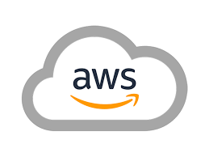
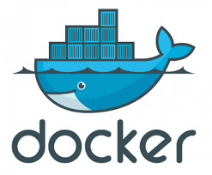
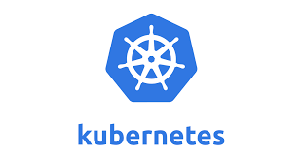
AWS, Docker and Kubernetes Build/Deployment

Slide 2
Technologies
Java 8 / 11
Maven / Gradle
PostgreSQL | MYSQL
AWS (IAM / EC2 / Cloud9 / EKS)
Docker (hub.docker.com account)
Kubernetes (On-Prem or EKS)

Slide 3
Requirements
Use your Spring Boot application what we have developed in Spring1 Demo
Deploy an application (we need application artifact. e.g: *.jar file, you can use Maven / Gradle)
Environment to deploy an application (QA/Pre-Prod/Prod), Create env in AWS EC2 instance with Kubernetes installed in ami-0057d8e6fb0692b80 (install docker and Kubernetes or user EKS)
Create the docker container and pushed into docker registry
Deploy the container with database (H2DB or MySQl or Other)
End user should be able to
Access application with browser or with any other tools like postman
Update the new feature with new version of code, generate new *.jar and build / push / deploy container
Redeploy the application with new container and end user should be able access it
Application deployment in Docker and Kubernetes.

Slide 4
Architecture your own

Slide 5
Final output Docker and Kubernetes

Slide 6
References
java -jar "C:\Users\Training\.m2\repository\sprintOne\EmpManSys\0.0.1-SNAPSHOT\EmpManSys-0.0.1-SNAPSHOT.jar"

